Slide 1
FAFSA Simplification

Slide 2
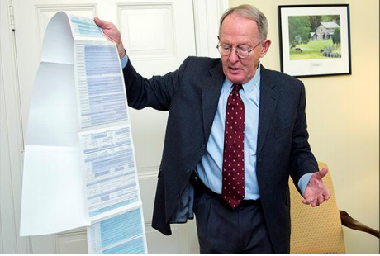
Future Changes
Omnibus legislation passed on December 21, 2020. It incorporated elements of Sen. Alexander’s previous FAFSA simplification legislation.
  Reduces the number of questions from 108 to about 36
  Reduced likelihood of verification - fewer questions and more data transferred from the IRS
The large majority of changes in this bill will not go into effect until the 2024–25 FAFSA (available 10/1/23)

Slide 3
Already Implemented Changes
Effective as of June 11, 2021
for the 2021-2022 FAFSA

Slide 4
Drug Convictions and Selective Service Registration
Drug Convictions and Selective Service Registration
Eliminates the suspension of federal aid eligibility for applicants with drug-related convictions.
Removes the requirement that male students must register with the Selective Service before the age of 26 in order to be eligible for federal aid.
Questions still on the FAFSA but are ignored and no longer impact eligibility.
Dear Colleague Letter – GEN-21-04
Early Implementation of the FAFSA Simplification Act’s Removal of Selective Service and Drug Conviction Requirements for Title IV Eligibility | Knowledge Center

Slide 5
Already Implemented Changes
Effective as of July 1, 2021

Slide 6
SULA - the maximum lifetime subsidized loan limit of 150% of published program length is repealed effective July 1, 2021.
Dear Colleague Letter – DL-21-04
150% Direct Subsidized Loan Limit: Electronic Announcement #25 – Guidance and Operational Information for the Repeal of 150% Subsidized Usage Limit (EA ID: DL-21-04) | Knowledge Center

Slide 7
Future Changes
Effective July 1, 2023

Slide 8
Pell Grants and Incarcerated Student
Pell Grant eligibility for incarcerated individuals has been restored.
  Student must be enrolled in an eligible prison education program.
  Institutions must be approved to participate
    Optional
    Proprietary institutions not eligible
Notes:
With the passage of the Consolidated Appropriations Act of 2021, the Department of Education will further expand the ability to serve incarcerated students beyond this experiment by reinstating Pell Grant eligibility for eligible students enrolled in certain prison education programs beginning July 1, 2023. In preparation for these legislative changes, increased participation in the Second Chance Pell experiment will allow the Department to determine what will be needed for institutions to comply with the new provisions. Additional participants will also ensure continued diversity in the experiment, allowing the Department to learn more about how to effectively implement the new legislation and provide insight on how best to serve incarcerated students in the future. In particular, the Department seeks to increase geographic diversity to include institutions from states not currently represented in the experiment.

Slide 9
Future Changes
Effective for the 2024-2025 FAFSA
(available October 1, 2023)

Slide 10
Name Changes
Goodbye EFC!
  The Expected Family Contribution (EFC) becomes the Student Aid Index (SAI)
    The term “EFC” can be misleading, since many families incorrectly believe that the EFC is all they pay
Simplified Needs Test (SNT) becomes Applicants Exempt from Asset Reporting

Slide 11
Need Analysis
Need Analysis & Pell Grant Eligibility
  Expected Family Contribution (EFC) is now Student Aid Index (SAI)
  SAI can be as low as -$1,500
  SAI determines eligibility for all Title IV aid except maximum and minimum Pell grant awards.

Slide 12
Two Pathways to Pell
Two Pathways to Federal Pell Grant Eligibility
  Formula similar to current formula that uses the SAI.
  Second formula overlays the standard formula and is based on the poverty line table and is used to determine maximum and minimum Pell eligibility.
Notes:
Eligible if the Student Aid Index ≤ 90% of maximum Federal Pell Grant
Amount of the Pell Grant = Maximum Pell Grant – Student Aid Index
Minimum Pell Grant = 10% of Maximum Pell Grant

Slide 13
Determine Pell Eligibility
Here’s how it works:
  Student is considered for maximum Pell first
  If student doesn’t qualify for maximum Pell, eligibility will be determined based on SAI:
      [Maximum Pell amount - SAI = Pell amount]
  If student doesn’t qualify for the maximum Pell and no Pell awarded from the SAI calculation, student is considered for minimum Pell.
            Based on # of parents in household and AGI vs. poverty
            Minimum Pell Grant = 10% of Maximum Pell Grant
Notes:
Eligible if the Student Aid Index ≤ 90% of maximum Federal Pell Grant
Amount of the Pell Grant = Maximum Pell Grant – Student Aid Index

Slide 14
Maximum Pell Grant Eligibility
Who qualifies for the maximum Pell Grant?
  Federal Tax Nonfilers - dependent children of nonfiling parent(s) and independent student (and spouse, if applicable) nonfilers
    Student Aid Index will be set to -1,500
  Children of certain deceased veterans and public safety officers
    Students under age 33 whose parent died serving in the armed forces after Sept. 11, 2001
    Students under age 33 whose parent died in the line of duty as a public safety officer

Slide 15
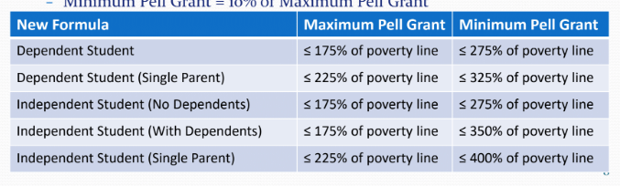
Maximum Pell Grant Eligibility continued….
Students qualifying based on income (by dependency status, # of parents - if dependent, dependents and marital status – if independent).
  Dependent students with parents who are not single parents whose parent AGI is below 175% of the poverty level
  Dependent children of a single parent whose parent AGI is below 225% of the poverty level
  Independent students who are not single parents whose student AGI is below 175% of the poverty level
  Independent students who are single parents and whose student AGI is below 225% of the poverty level

Slide 16
Pell Eligibility Based on the SAI
If not eligible for maximum Pell, eligibility will be determined based on the Student Aid Index (SAI).
  [Maximum Pell amount - SAI = Pell amount]
  For example, assume:
    Maximum Pell = $6,495
    SAI = 4,250
    $6,495 – 4,250 = $2,245 in Pell eligibility

Slide 17
Pell Eligibility Based on Minimum Pell
If not eligible for the maximum Pell and no Pell awarded from the SAI calculation, student is considered for minimum Pell.
  Based on income (by dependency status, # of parents - if dependent, dependents and marital status – if independent).
Minimum Pell Grant = 10% of Maximum Pell Grant

Slide 18
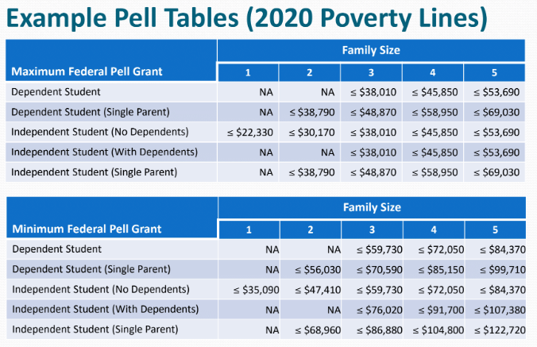
Poverty Tables and Pell Grant Eligibility

Slide 19
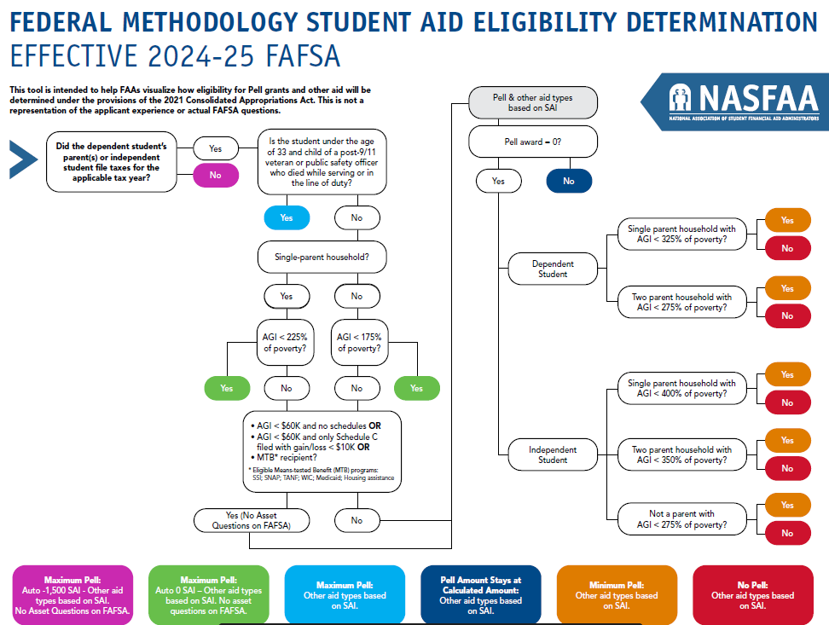

Slide 20
Which Parent(s) Must Complete the FAFSA?
Currently, if a dependent student’s parents are divorced or separated, the parent the student lived the most during the 12 months before filing the FAFSA is responsible for completing the FAFSA.
Starting with the 2024-2025 FAFSA, the parent who provides the greater portion of the student’s financial support will be responsible for completing the FAFSA.
  In the case where both parents provide equal financial support, the parent with greater income is responsible for completing the FAFSA.
If this parent has remarried as of the date the FAFSA is filed, the stepparent’s information is required as well.

Slide 21
Multiple Children in College
The parent SAI will no longer be divided by number of children in college at the same time
  Small impact on low-income families with multiple children in college
  Bigger impact on middle- and high-income families with two or more children in college at the same time
The income protection allowance (IPA) is being increased, which should result in lower SAIs and will help offset this change a bit.
  Increases by 20% for parents
  Increases by up to about 35% for most students
  Increases by up to about 60% for students who are single parents
Notes:
Families can appeal for more aid based on having multiple family members in college at the same time

Slide 22
IRS Definition of Dependent
Dependents include qualifying children and qualifying relatives
  Qualifying children
    Must live with the parent for more than half the year
    Must not provide more than half of their own financial support
    Financial aid no longer counts as part of the student’s self-support
    Must be under age 19 (24 if a full-time student)
    If the child is married, they must not file a joint return with their spouse
  Qualifying relative
    Dependents may include other people if they receive more than half their support from the parent

Slide 23
Applicants Exempt from Asset Reporting (was SNT)
The Simplified Needs Test is now known as “Applicants Exempt from Asset Reporting”
  No asset questions for:
    Means Tested Benefits recipients
      Free and Reduced Lunch removed
      Federal Housing Assistance added
      No additional income threshold
    AGI < $60K and no lettered tax schedules
    AGI < $60K and only Schedule C, provided Schedule C gain/loss < $10K
Notes:
The means-tested federal benefits include SSI, SNAP, TANF, WIC, Medicaid and Federal Housing Assistance (new) - Free and Reduced Price School Lunch has been dropped from the list of meanstested federal benefits

Slide 24
Changes in Reportable Income
Several types of untaxed income will no longer be reported on the FAFSA
  Veterans’ education benefits
  Worker’s Compensation
  Cash support and other money paid on the student’s behalf
    This change means that:
      Gifts to the student will no longer be reported as untaxed income
      Qualified distributions from 529 plans that are owned by a grandparent, aunt, uncle, etc. will no longer affect aid eligibility
Child support received (annual) will be reported as an asset instead of income
Notes:
Veterans Affairs Student Work-Study Allowance Program (VASWSAP)

Slide 25
Changes in Reportable Assets
Certain exclusions from assets have been dropped
  The small business exclusion
  Exclusion for a family farm
Notes:
The means-tested federal benefits include SSI, SNAP, TANF, WIC, Medicaid and Federal Housing Assistance (new) - Free and Reduced Price School Lunch has been dropped from the list of meanstested federal benefits

Slide 26
Dependency Override Changes
Provisional Independent Status
  Allows otherwise dependent students to complete the FAFSA as a “provisional” independent student if they believe they have unusual situations and believe they meet the criteria for a dependency override.
  SAI to be calculated and student would receive estimated Pell Grant on SAR
  School would be required to notify these students of the institution's process, requirements, and timelines review.

Slide 27
Dependency Override Changes
Dependency overrides will be assumed to continue for the duration of the student’s entire college enrollment unless school:
  is informed by the student of changes to their circumstances; or
  has conflicting information.

Slide 28
Financial Aid Appeals
Schools may no longer have a policy of denying all financial aid appeals.
New examples of special circumstances:
  Unusual business, investment and real estate losses
  Severe disability of the student, parent or spouse
Income earned from work may be set to zero due to unemployment during a qualifying emergency.
Eligibility for unsubsidized Federal Direct Stafford Loans no longer requires parents to cut off financial support.

Slide 29
Changes to Cost of Attendance
Changes to room and board
  Schools cannot zero out room and board for students who live with their parents.
  The allowance for board (food) must provide the equivalent of at least three meals per day.
Transportation expenses include travel between home, school and work.
Changes to loan fees:
  Actual loan fees for federal loans must be included in the cost of attendance.
  Loan fees for private student loans may no longer be included.
Cost of professional licensing, certification or first professional credentials incurred during the academic year must be included in cost of attendance (currently optional).

Slide 30
Other Changes
Emergency financial aid funds will not reduce the student’s other financial aid.
New question about the student’s race or ethnicity.
The allowance for state and other taxes has been dropped.
Paid FAFSA preparation will no longer be permitted.
FAFSA will identify eligibility for other means-tested benefits.
Notes:
Subsidized Usage Limit Applies

Slide 31

Thank you for joining us today! Find more FREE resources and information at FAMEmaine.com/education.
Follow us:
Contact: education@FAMEmaine.com
PH: 207-623-3263 or 800-228-3734 TTY: 207-626-2717

