Slide 1
FAFSA Simplification
Rebecca McFarland
Director of Compliance & Audit
Southern New Hampshire University
Student Financial Services

Slide 2
Who am I?
Rebecca McFarland
UMaine Orono ‘10
UNH ‘12
Mom
Hockey Mom
Husky Mom
Director of Compliance in SFS at SNHU

Slide 3
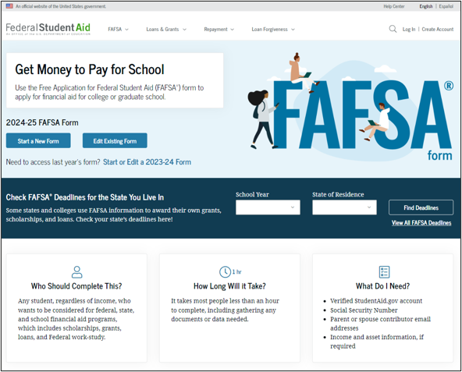
Agenda
Implementation of SAI
The switch to FTI
Removal of the Housing Question
Chat life!

Slide 4
Language Changes

Slide 5
What are some Big Changes
Special Circumstance
Special or extenuating circumstances (such as job loss) that impact their financial condition.
Unusual Circumstance
Conditions that justify a change to the student's dependency status
Provisionally Independent Student
if a student indicates they have unusual circumstances or indicates for the first time they are unaccompanied and homeless, or at risk of being homeless (without a designation from a specified entity), the FPS will consider the student to be provisionally independent and will allow them to fill out the FAFSA form as an independent student. The SAI will remain provisional and not official until the student’s college or career school makes a final determination. The ISIR will have a specific reject code that will require the FAA to review, and if applicable, confirm the student’s independent status.
FAFSA Partner Portal (FPP)
Replace FAA Access to CPS
FAFSA Processing System (FPS)
Replaces CPS
Federal Tax Information Module (FTIM)
Receives, stores, uses, and controls individual FTI
FTI SAIG Mailbox
New SAIG Mailbox
FUTURE Act Direct Data Exchange (FA-DDX)
Replaces the DRT; allows ED to request and for the IRS to transfer FTI

Slide 6
Implementation of SAI

Slide 7
Pell Grant Eligibility
Maximum Pell Grant
Calculated based on tax-filing status, AGI, poverty guidelines, and
family size
Calculated Pell Grant
Pell Grant = Maximum Scheduled Pell minus Calculated SAI (adjusted
for enrollment)
Minimum Pell Grant
Calculated only if a student’s SAI is greater than Maximum Scheduled
Pell for the award year.
https://fsapartners.ed.gov/sites/default/files/2023-05/202425DRAFTSAIGuideSupplementEligibilityforMaxorMinPellGrantResource.pdf

Slide 8
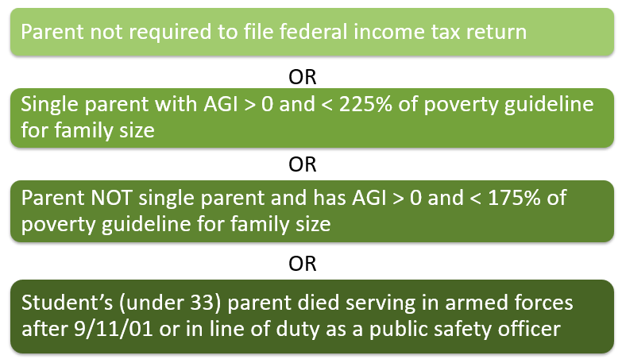
Maximum Pell Grant

Slide 9
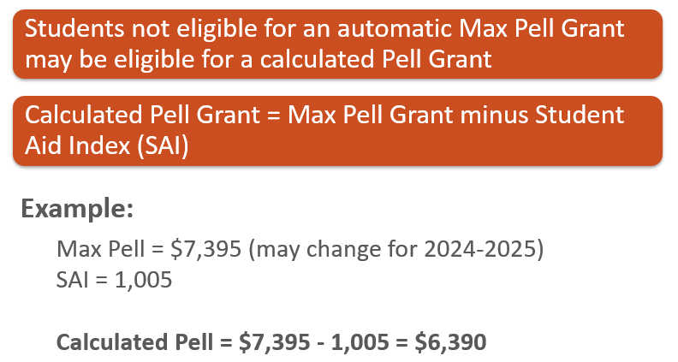
Calculated Pell Grant

Slide 10
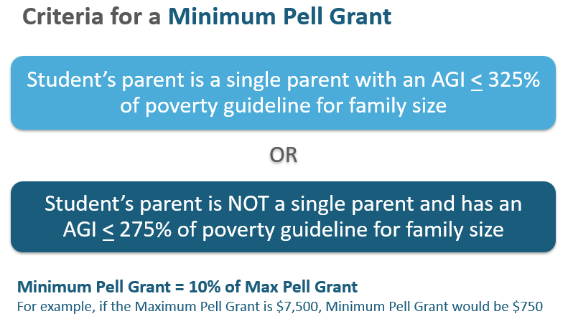
Minimum Pell Grant

Slide 12
Federal Tax Information

Slide 13
First, what is it?
Prior to the 24/25 year, students and families used the Data Retrieval Tool (DRT) to pull in their information
Starting this year, students and parents will have their IRS information pulled into the FAFSA by using the FUTURE Act Direct Data Exchange (FA-DDX) system

Slide 14
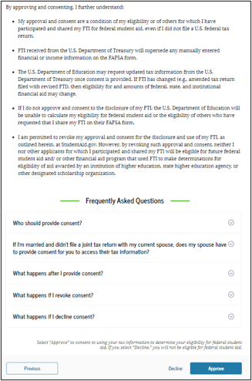
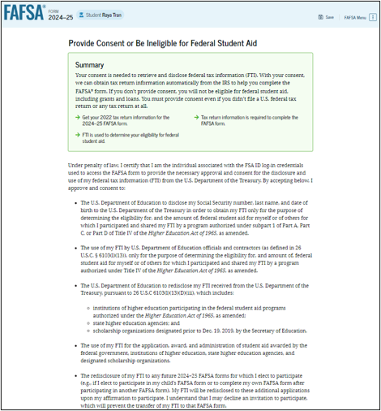
Consent
This page will inform students and parents about consent and their federal tax information.
By approving their consent, this will allow their federal tax information into the FAFSA.
Students, Parents, and other Contributors will all need to consent in order to process the student’s SAI

Slide 15
No Longer Required
Cash support and other money paid on behalf of the student
529s in other people’s names
Veteran’s education benefits
Workman’s compensation
Payments to tax-deferred pensions not on the federal tax return
Other untaxed income sources
Child support PAID out of the household
NOTE: Child support received will be moved to the asset section of the form. Families who do not report assets, will not need to provide this information.

Slide 16
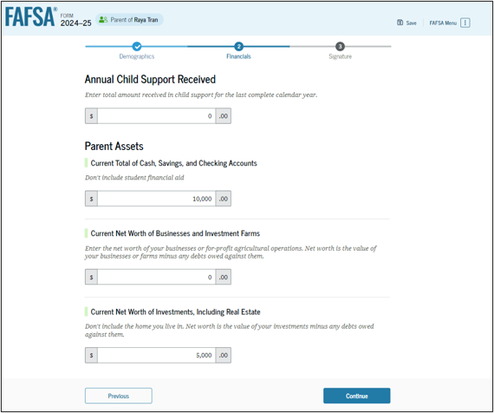
Now Required
Annual Child Support Received
Must now be reported as a parent asset
Business/Farm no longer exempt
This includes fair market value, buildings, livestock, unharvested crops, machinery

Slide 17
Housing Question

Slide 18
Housing Plans?
With the FAFSA Simplification Act, the Department can no longer ask students what their choice of housing is on the FAFSA form
How is your school planning on determining housing status?

Slide 19
Thank You
2500 North River Road
Manchester, NH 03106
r.mcfarland1@snhu.edu
snhu.edu

